Slide 1
SQL Project
We want to find out how the two stores compare in number of rentals (overall and monthly) and types of rentals.
Jenny Jung

Slide 2
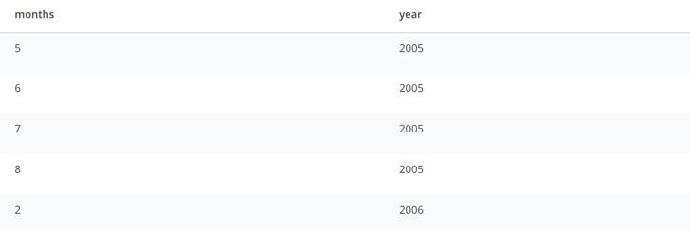
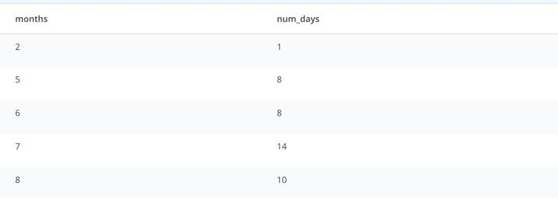
Query 1: determining whether dates are equally distributed; which months to be queried upon while looking into rental counts?
February, 2006 is the only month with one day. Only from may, 2005 - aug, 2005 can be considered in the query.
Notes:
sql: (are dates evenly distributed?)
WITH main AS (
SELECT CAST(
DATE_PART('year', rental_date) || '-' ||
DATE_PART('mon', rental_date) || '-' ||
DATE_PART('day', rental_date) AS DATE) AS rented_on,
rental_id,
i.store_id
FROM rental r
JOIN inventory i
ON i.inventory_id = r.inventory_id),
/* FIRST, THERE'S ONLY ONE MONTH IN 2006 */
SELECT DISTINCT
DATE_PART('month', rented_on) AS months,
DATE_PART('year', rented_on) AS year
FROM main
ORDER BY year, months
/* next, looking at number of days in each month in the overall ‘rental’ dataset */
SELECT months,
COUNT(DISTINCT days) num_days
FROM (
SELECT DISTINCT
DATE_PART('month', rented_on) AS months,
DATE_PART('day', rented_on) AS days
FROM main
) sub
GROUP BY 1
/*finally, looking at each store’s dates */
SELECT months,
COUNT(DISTINCT days) num_days
FROM (
SELECT DISTINCT
DATE_PART('month', rented_on) AS months,
DATE_PART('day', rented_on) AS days
FROM main
WHERE store_id = 1
) sub
GROUP BY 1
SELECT months,
COUNT(DISTINCT days) num_days
FROM (
SELECT DISTINCT
DATE_PART('month', rented_on) AS months,
DATE_PART('day', rented_on) AS days
FROM main
WHERE store_id = 2
) sub
GROUP BY 1

Slide 3
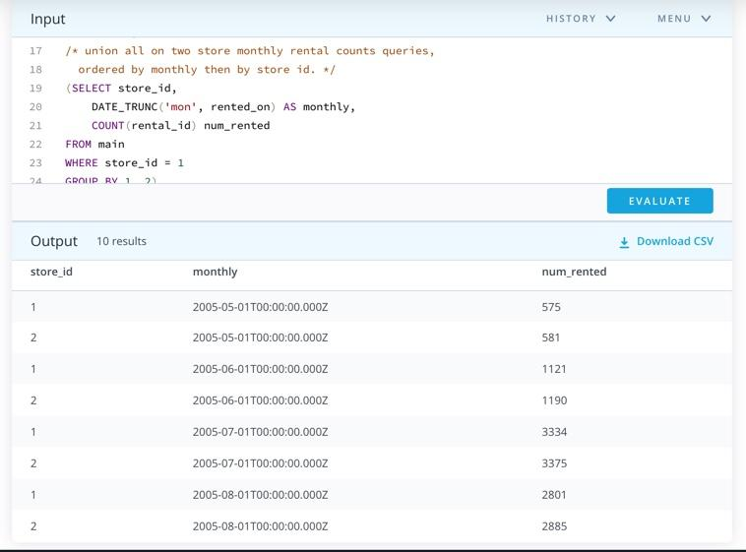
Query 2: Throughout May 2005 -August 2005, how are the two stores differ in counts of rentals?
Counts of rentals in two stores were shown one by one for each month. The rental counts are in ascending order in each month.
Notes:
st1 AS (
SELECT DISTINCT
month,
year,
store_id,
COUNT(rental_id) OVER (PARTITION BY month) AS num_rented
FROM (
SELECT
DATE_PART('year', rented_on) AS year,
DATE_PART('month', rented_on) AS month,
rental_id,
store_id
FROM main
WHERE store_id = 1 AND DATE_PART('month', rented_on) != 2) t1
),
/* store 2 */
st2 AS (
SELECT DISTINCT
month,
year,
store_id,
COUNT(rental_id) OVER (PARTITION BY month) AS num_rented
FROM (
SELECT
DATE_PART('year', rented_on) AS year,
DATE_PART('month', rented_on) AS month,
rental_id,
store_id
FROM main
WHERE store_id = 2 AND DATE_PART('month', rented_on) != 2) t2
/*Now, join the two table to compare (here I can add visuals )*/
SELECT *
FROM
(SELECT *
FROM st1
UNION ALL
SELECT *
FROM st2) u1
ORDER BY num_rented DESC

Slide 4
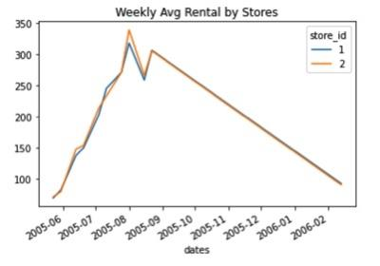
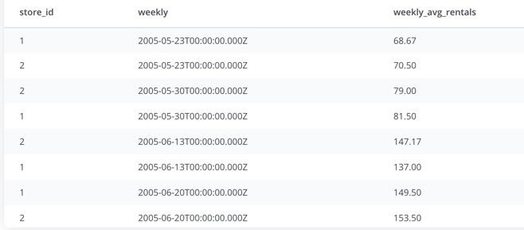
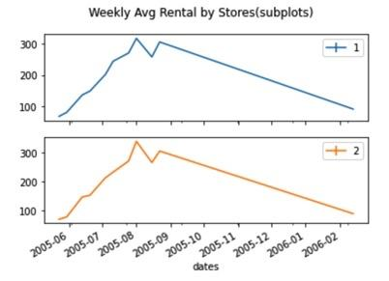
QUERY 3: 7 day rolling mean for rental counts in each store?
7 day rolling means for two stores seems quite similar in number of rentals.
Notes:
WITH rental_dates AS (
SELECT CAST(
DATE_PART('year', rental_date) || '-' ||
DATE_PART('mon', rental_date) || '-' ||
DATE_PART('day', rental_date) AS DATE) AS rented_on,
rental_id,
i.store_id
FROM rental r
JOIN inventory i
ON i.inventory_id = r.inventory_id
),
daily_rented AS (
SELECT store_id,
rented_on,
COUNT(rental_id) daily_count
FROM rental_dates
GROUP BY store_id, rented_on
ORDER BY rented_on)
SELECT store_id,
DATE_TRUNC('week', rented_on) AS weekly,
ROUND(AVG(daily_count), 2) weekly_avg_rentals
FROM daily_rented
GROUP BY 1, 2
ORDER BY 2

Slide 5
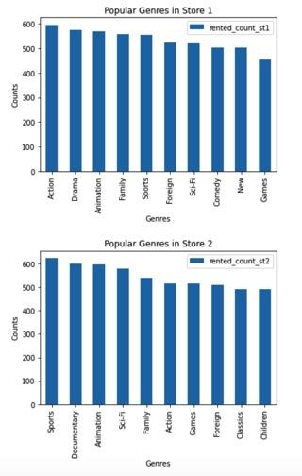
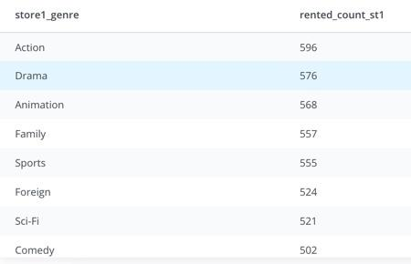
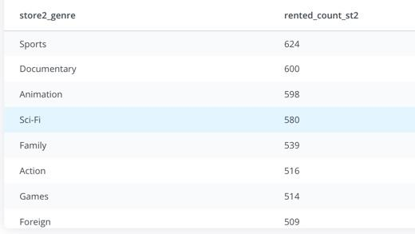
QUERY 4: how do two stores different in the type of film genres rented?
(what are the top 10 genres rented in each store?)
Stores 1 and 2 had differences in top favorite genres. In store 1, top genre rented was Action, while store 2 had Sports as top rented. Both were similar in that animation films came in 3rd place with similar rental counts. The two stores were also different in least rented genres.
Notes:
sql: (TOP GENRE RENTED?)
WITH st1_genre AS (
SELECT c.name genre,
r.inventory_id
FROM rental r
JOIN inventory i
ON i.inventory_id = r.inventory_id
JOIN film_category fc
ON fc.film_id = i.film_id
JOIN category c
ON c.category_id = fc.category_id
WHERE i.store_id = 1),
st2_genre AS (
SELECT c.name genre,
r.inventory_id
FROM rental r
JOIN inventory i
ON i.inventory_id = r.inventory_id
JOIN film_category fc
ON fc.film_id = i.film_id
JOIN category c
ON c.category_id = fc.category_id
WHERE i.store_id = 2)
/*STORE 1 GENRES RENTED COUNTS IN DESCENDING ORDER */
SELECT st1.genre store1_genre,
COUNT(st1.inventory_id) rented_count_st1
FROM st1_genre st1
GROUP BY 1
ORDER BY 2 DESC
/* STORE 2 GENRES RENTED COUNTS IN DESCENDING ORDER */
SELECT st2.genre store2_genre,
COUNT(st2.inventory_id) rented_count_st2
FROM st2_genre st2
GROUP BY 1
ORDER BY 2 DESC

